Slide 1
UFO sightings analysis
Andrew Jalnine

Slide 2
Abstract
Used UFO sightings dataset, geographical datasets and USA weather archive
Research questions:
1. Find patterns in distribution of UFO sightings in USA
2. Find relations between UFO sightings and weather conditions
Methods:
Visualizations, cluster analysis, classification, basic statistics, etc
Analysis covers 2010-2014 years

Slide 3
Motivation
Any unexpected object in atmosphere can be dangerous to aircrafts.
At least because of this UFO phenomena exploration is important.

Slide 4
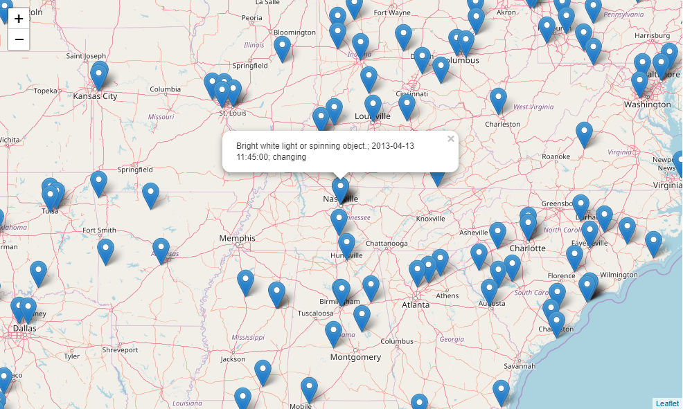
Datasets
1. UFO sightings:
Contains coordinates,
timestamp and brief
description
Found at Kaggle

Slide 5
Datasets
US cities coordinates. Found at simplemaps
Weather archive. Contains worldwide daily measures with related weather station codes. Used data for 2010-2014 years. Found at National centers for environmental information. Contains measures: precipitations, snowfalls, temperatures (min and max per day).
Weather stations metadata. Contains station codes and coordinates. Found also at National centers for environmental information

Slide 6
Data Preparation and Cleaning
Many data transformations implemented, because analysis using several heterogeneous datasets. Used operation are dataset merging, pivot table, concatenation, filtering, grouping etc.
UFO sightings dataset contains hand input mistakes. Data preparation required checking, parsing, error filtering and type convertions.
Main problem is large size of weather dataset (before any transformations and filtering is about 6 Gb). Due to RAM limitations used chunked operations.
Binding each sighting to closest weather station or city requires tables join by minimal distance objects on earth (calculated via haversine formula), that is very slow operation and requires optimisations.

Slide 7
Research Questions
1. Find patterns in distribution of UFO sightings. Includes subquestions:
Check if distribution can be divided on clusters
Determine places with highest density of sightings
2. Try to find relations between UFO sightings and weather conditions.
If model can predict UFO sighting by generic weather parameters with low errors, then sighting can be classified as weather phenomena

Slide 8
Methods
Cluster analysis. Used K-means with determination of number of clusters by elbow method. Clusters visualized on map with 99% confidence circles.
Decision tree classification. Used to find relation between weather parameters and UFO observations. By model error we can determine how much part of sightings is weather phenomena.
Basic statistics, distribution analysis. Too wide latitude range can reduce quality of weather model because of very different climatic conditions. This required latitude distribution analysis and data filtering.
Visualizations – maps, violin plots, etc

Slide 9
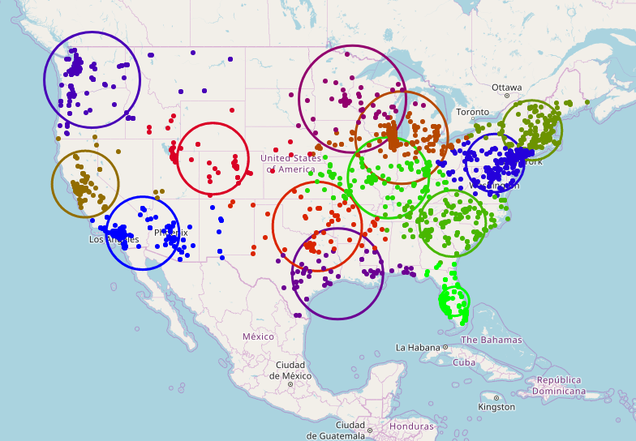
Findings
Found that UFO sightings
can be clustered
with number
of clusters k=15

Slide 10
Findings
Anchorage
Beaumont
Chicopee
Daly City
Decatur
Gary
Grand Junction
Lancaster
Lodi
McKinney
Poinciana
Rock Hill
Woodbury
Yakima
Clusters formed
around this cities*:
*with population at least 50 000 peoples

Slide 11
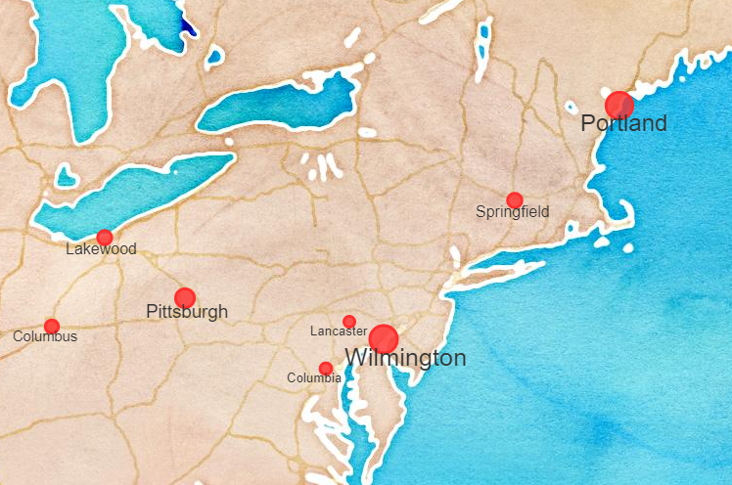
Findings
Cities* with highest sighting rate:
Around Wilmington and Portland
average sighting rate about
1 sighting per week
*with population at least 50 000 peoples

Slide 12
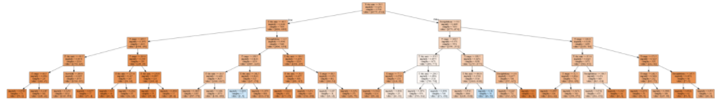
Findings
Decision tree classification can’t predict UFO sighting by weather conditions
Only 1.75% of predictions is correct for test data (depth of tree = 5).

Slide 13
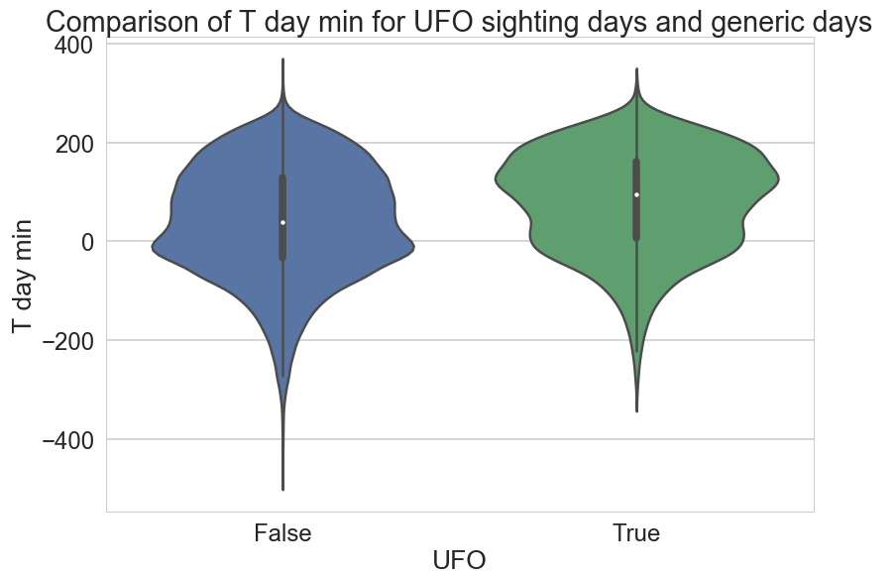
Findings
Sightings often occurs
in warm days
It can be explained
by farther visibility
sighting

Slide 14
Limitations
Many stations records only basic weather parameters. Filtering dataset by non-empty values for more parameters reduces dataset to unappropriate size. Because of this, only few weather parameters used for analysis.
Results would be more correct if used per-hour weather data, but this requires more resources than available.

Slide 15
Conclusions
UFO sightings can be clustered around 15 cities
Found cities with very high sighting rate (about 1 per week)
UFO sighting can not be predicted by generic weather parameters
UFO sighting often occurs in warm days
Deeper analysis requires more resources than available

Slide 16
Acknowledgements
Thanks to:
Kaggle,
National centers for environmental information,
Simplemaps
for free access to datasets

Slide 17
References
NumPy is the fundamental package for scientific computing with Python.
pandas: powerful Python data analysis toolkit
Scikit-learn Machine Learning in Python
Matplotlib is a Python 2D plotting library
Folium. Make beautiful maps with Leaflet.js & Python
Seaborn: statistical data visualization

